Slide 1
Sharing Your Research
Dr. Deana Pennington
University of Texas at El Paso
June 10, 2017

Slide 2
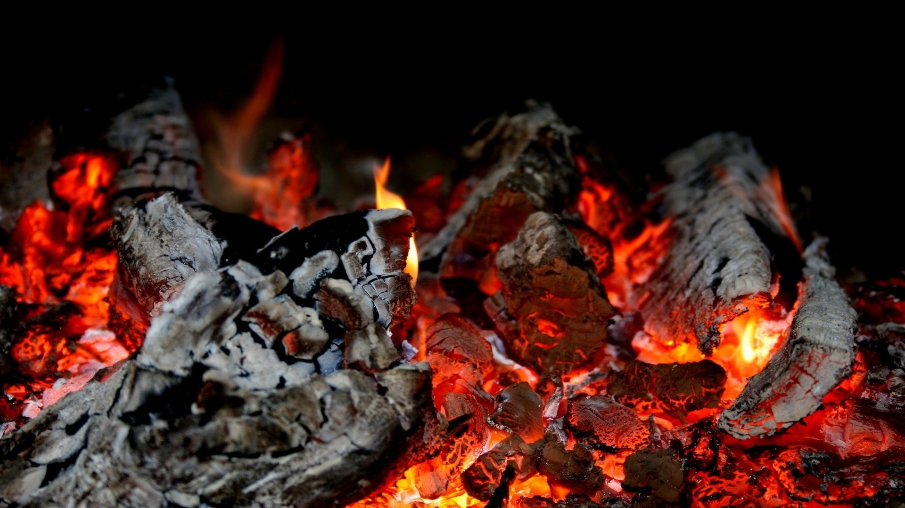
Introducing EMBeRS
Lighting the fire of interdisciplinary teamwork
Notes:
EMBeRS is a research project funded by the National Science Foundation focused on developing group activities that enable better interdisciplinary research and education. It is a collaboration between earth and environmental scientists, and learning scientists.

Slide 3
The EMBeRS Approach
We simplify the world through models – mental, conceptual, simulation, etc.
In interdisciplinary work, we must co-develop shared mental models of the problem
External representation of mental models facilitates co-creation of a shared problem model
EMBeRS activities target participatory conceptual modeling using external representations, also known as boundary negotiating objects

Slide 4
Goals of this EMBERS activity
Represent and share your research with others from different disciplines
Engage in active listening
Reflect on what makes knowledge exchange across disciplines difficult

Slide 5
Part 1: Communicating your research
Understand the issues
Learn about some strategies

Slide 6
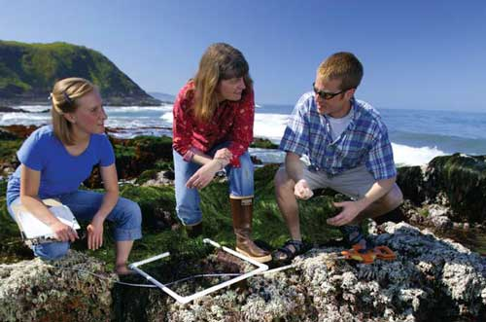
The Problem
Study people
“…I study phenomenology, hermeneutics and structuration theory”
Study computation
“First you must convert your data to RDF and then we can use machine learning…”
Study nature
“The phenology and productivity of a C3 grass…”

Slide 7
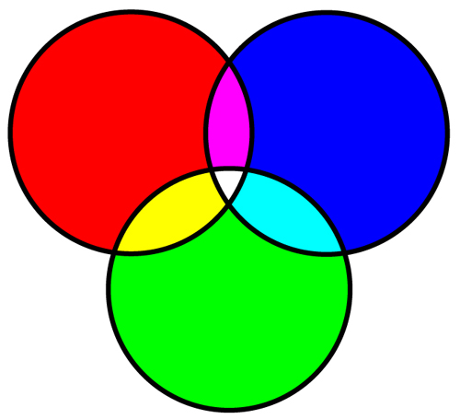
Disciplinary Training
Different cultures:
Ways of working
Methods
Data types
Values
Motivations
Epistemologies
Uncertainty tolerance
Etc.
Social
Scientist
Natural
Scientist
Different knowledge:
Freshman/
Sophomore
Core
Curriculum
Engineer

Slide 8
Mental Models
Real world phenomenon
Mental model
Our minds are rather messy places!

Slide 9
Explaining Perspectives
Communication issues:
Explainer:
Deep knowledge
Research frontiers
Difficult to simplify
Difficult to represent
Learner:
Lack of foundational concepts
Jargon unknown
No comparable mental model
No perceived connections to their own knowledge

Slide 10
Model-Based Reasoning
Models: Analogies, metaphor, thought experiments, visual models, semantic models and/or simulation models…
used for abstraction and communication of complex concepts
Models enable the offloading and summarizing of complex information so that individuals can grasp and manipulate more information
(Ifenthaler 2013)
Model-based reasoning:
Employing models to invoke conceptual change
Reasoning by mental modeling possibly aided by external devices
(Nersessian 1999)

Slide 11
The EMBeRS Appraoch
INCORPORATION OF EXTERNAL REPRESENTATIONS
Every activity includes drawing, diagraming, charting, etc.
Intentionally invoke model-based reasoning
PURPOSEFUL INDIVIDUAL REFLECTION
Active listening – pay attention, try to grasp what they mean, ask for clarification
Try to connect it to what you already know
STRUCTURED PROCESS
Participatory – everyone has a turn

Slide 12
Presenter: externalizing & sharing
No right or wrong way to externalize
Objective: simplify and organize the messy knowledge in your head about your research area
In a way you believe will make sense to the listener
Avoid too much detail – 6-8 main points
Avoid jargon
Explain disciplinary terms
Hold to your alloted time

Slide 13
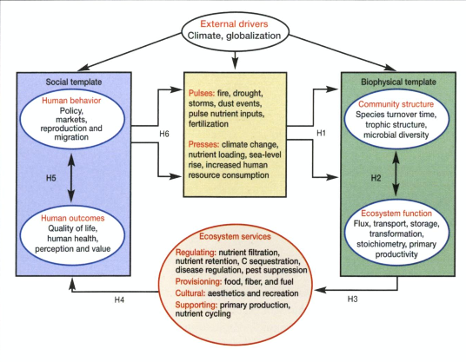
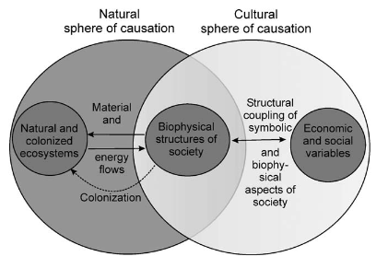
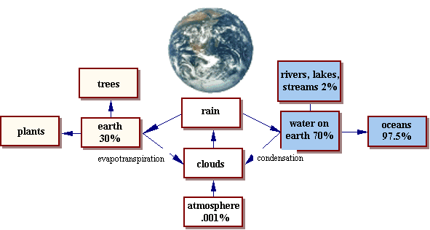
Examples of external representation

Slide 14
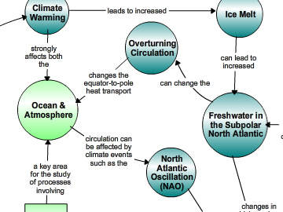
Concept map
Image from

Slide 15
Active listening: non-presenter
Listening for understanding
Listen attentively – don’t be distracted
Clarify terminology
Ask thoughtful questions
Ask for a repeat of the statement
State what you think you understand for confirmation or clarification
You are trying to learn the other perspective
NOT listening for rebuttal
You will get your turn
DON’T spend time thinking about what you will say
DON’T hijack the discussion

Slide 16
Part 2: Now Let’s Do It!
Get in groups identified by instructor
These instructions assume groups of 4

Slide 17
Tools
Paper 11”x13” or larger
Sticky notes
Markers
Concept mapping tool (demo if you use this)

Slide 18
Individual representations (20 min)
Using sticky notes, list five phenomena or theories (keywords) that are most important to your research
Arrange them on the paper so that relationships between them can be shown with markers
Add keywords as necessary
Label the relationships with brief explanatory phrases

Slide 19
Share in your group (40 min)
Whose last name is first in the alphabet? You start!
Each person has 10-12 minutes
Then shift to next person on right
40 minutes total – instructor notify every 10 minutes
Remember: ACTIVE LISTENING, PAY ATTENTION, CLARIFY VOCABULARY, RESTATE WHAT YOU THINK YOU UNDERSTAND, DON’T WORRY ABOUT YOUR TURN

Slide 20
Summarize (5 mins)
In one minute, summarize the research of the person on your RIGHT

Slide 21
Learning across disciplines (5 min)
In one minute, state something new you learned from someone else in the group

Slide 22
Reflection (10 mins)
Within your group, list:
3-5 challenges that you encountered
3-5 things that helped

Slide 23
Report out (10)
What were the challenges and aids?
Let’s combine our lists.

Slide 24
Wrap up (5 min)
Explaining your research to someone outside your discipline is very difficult
Pay attention to your jargon and assumptions
Listen actively to others
Use diagrams as a way to organize your thinking in advance of explaining
Design a lightly structured, participatory process

Slide 25
Acknowledgements
2006-13 NSF OCI-0636317, OCI-0753336, OCI-1135525
2013-15 SESYNC DBI-1052875
2015-18 NSF DGE-1545404
EMBeRS team: Gabriele Bammer, Antje Danielson, Dave Gosselin, Geoffrey Habron, Dave Hawthorne, Rod Parnesll, Kate Thompson, Shirley Vincent
REMEMBER EMBERS!

