Slide 1
Challenges and Opportunities in Convergent Team Research
Created by Dr. Deana Pennington
University of Texas at El Paso
March 28, 2017

Slide 2
EMBeRS
Lighting the fire of interdisciplinary teamwork
Notes:
EMBeRS is a research project funded by the National Science Foundation focused on developing group activities that enable better interdisciplinary research and education. It is a collaboration between earth and environmental scientists, and learning scientists.

Slide 3
Goals of this EMBERS session
Part 1: Learn key concepts and terminology
Part 2: Identify personal motivations that impact participation in interdisciplinary research
Part 3: Identify factors that facilitate or inhibit successful collaboration
Part 4: Introduce the EMBeRS approach

Slide 4
Part 1: Key concepts and terminology

Slide 5
What is team science? Vocabulary Pt 1
Team science: Collaborative, often cross-disciplinary approaches to research on a particular topic.
Cross-disciplinary: Includes perspectives from two or more disciplines. Includes multidisciplinary, interdisciplinary, and transdisciplinary
Multidisciplinary, interdisciplinary, and transdisciplinary: Used in different ways

Slide 6
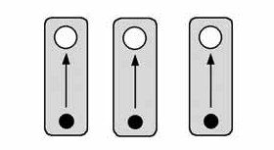
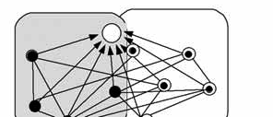
What is team science? Vocabulary Pt 2
Researcher
Research goal
Research frameworks
Thematic
umbrella
Disciplinary
Multidisciplinary
Interdisciplinary
Transdisciplinary
Tress, Tress & Fry 2002

Slide 7
What is convergence?
The process of converging on something from multiple directions.
In scientific research, it describes the process of converging on a solution that benefits society through comprehensive integration of multiple science and technology perspectives
It requires interdisciplinary research, but not all interdisciplinary research qualifies as convergent science
Driven by societal problem
Comprehensive – all key perspectives relevant to generating a solution

Slide 8
Discussion (10 min)
What is the difference between basic and applied science? How do these relate to interdisciplinary and/or convergent science?

Slide 9
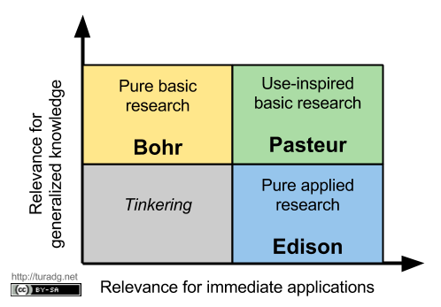
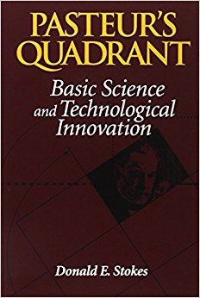
Pasteur’s Quadrant
Stokes (1997)

Slide 10
Co-Innovation
Invention: A novel new idea, conceptualization, method, tool, object
Innovation: An invention that has impact on something/someone beyond the inventor(s)
Co-innovation: Inventions that mutually impact each other
High
Interdisciplinary
Research
Discipline 2
Knowledge
Discipline 2
Research
Not a good place
to be as a researcher
Discipline 1
Knowledge
Low
Low
Discipline 1
Research
High

Slide 11
The big idea
Vision: To successfully solve some of societies most pressing socio-environmental issues
Mission: To learn how to more effectively engage in interdisciplinary team science to facilitate converging on salient solutions
Goals:
Understand processes that enable generation of co-innovative research
Awareness and management of factors that inhibit co-innovative research
Develop future leaders with the knowledge, skills, and attitudes necessary to successfully lead interdisciplinary research teams towards relevant solutions

Slide 12
Part 2: Personal motivations

Slide 13
Transdisciplinary Orientation Scale
Complete the survey (15 min)
Link to survey here, or hand out paper copies
Modified from: Misra, S., Stokols, D., & Cheng, L. (2015). The Transdisciplinary Orientation Scale: Factor Structure and Relation to the Integrative Quality and Scope of Scientific Publications. Journal of Translational Medicine & Epidemiology, 3(2), 1042.

Slide 14
Five intrapersonal factors
TD values
TD attitudes
TD beliefs
TD conceptual skills
TD behaviors
Misra et al (2015)
Two factor model: VAB & CB

Slide 15
TD values
Core guiding principles:
Value collaborative research in addressing social and environmental issues
Inclusive of worldviews and paradigms divergent from your own
Open to learning about theories and methods with which you are unfamiliar
Respectful and tolerant toward other points of view

Slide 16
TD Attitudes
Willingness to invest time and effort in:
Learning other fields
Tackling complex problems

Slide 17
TD Beliefs
Believe that:
Benefits outweigh costs
You are more productive working in teams
Important theoretical and empirical discovers will result
Valuable societal outcomes will result

Slide 18
TD Conceptual Skills
Ability to view research problems holistically from distinct vantage points
Ability to traverse multiple levels of analysis
Capacity to create conceptual frameworks accounting for manifold causes and consequences, building on multiple fields, and synthesizing diverse paradigms
Systems thinking skills
Knowledge management strategies
Stakeholder analysis skills
Anticipatory governance skills

Slide 19
TD Behaviors
Read journals from different fields
Engage with colleagues from other disciplines to share and integrate ideas
Use research methods from other fields
Communicate respectfully with colleagues
Gain experience working in cross-disciplinary teams

Slide 20
Five intrapersonal factors
TD values
TD attitudes
TD beliefs
TD conceptual skills
TD behaviors
EMBeRS activities: Dispositional Characteristics Parts 1 & 2
Disciplinary Cultures
EMBeRS activities:
Share Your Research
Mock Solicitation
Case Study (6 parts)

Slide 21
Activity: think-group-share
Individually, think of one good example of a colleague you work with demonstrating either positive or negative values, attitudes, beliefs, skills, or behaviors impacting the success of interdisciplinary teamwork. Briefly summarize the situation on a notecard (10 minutes)
Groups of 3 or 4: Share your examples within your group (15 min)
Tape your notecard to the whiteboard in the closest category (5 min)
All: browse the notecards, followed by a group discussion (20 min)
Total time: 40 min

Slide 22
Part 3: Factors that facilitate/inhibit

Slide 23
Another think-group-share Activity
Objective: Create a comprehensive list of factors that impact the success of interdisciplinary team science, and group them into categories
First: individual reflection (10 minutes)
Then: groups of 4 combine lists (15 minutes)
Next: everyone combines lists (15 minutes)
Last: compare results with published literature (5 minutes)
Total: 45 minutes

Slide 24
Individual reflection (10 minutes)
Using sticky notes, jot down words or short phrases that capture a factor that you believe to impact the success or failure of team science

Slide 25
Groups of 3-4 (15 minutes)
Compare your sticky notes
Group similar factors into categories.
Create a label for each category you create

Slide 26
Entire group (15 minutes)
Each group list their categories on the whiteboard
Group discussion: which categories are similar? Which are unique?
Create a combined list of categories on the whiteboard

Slide 27
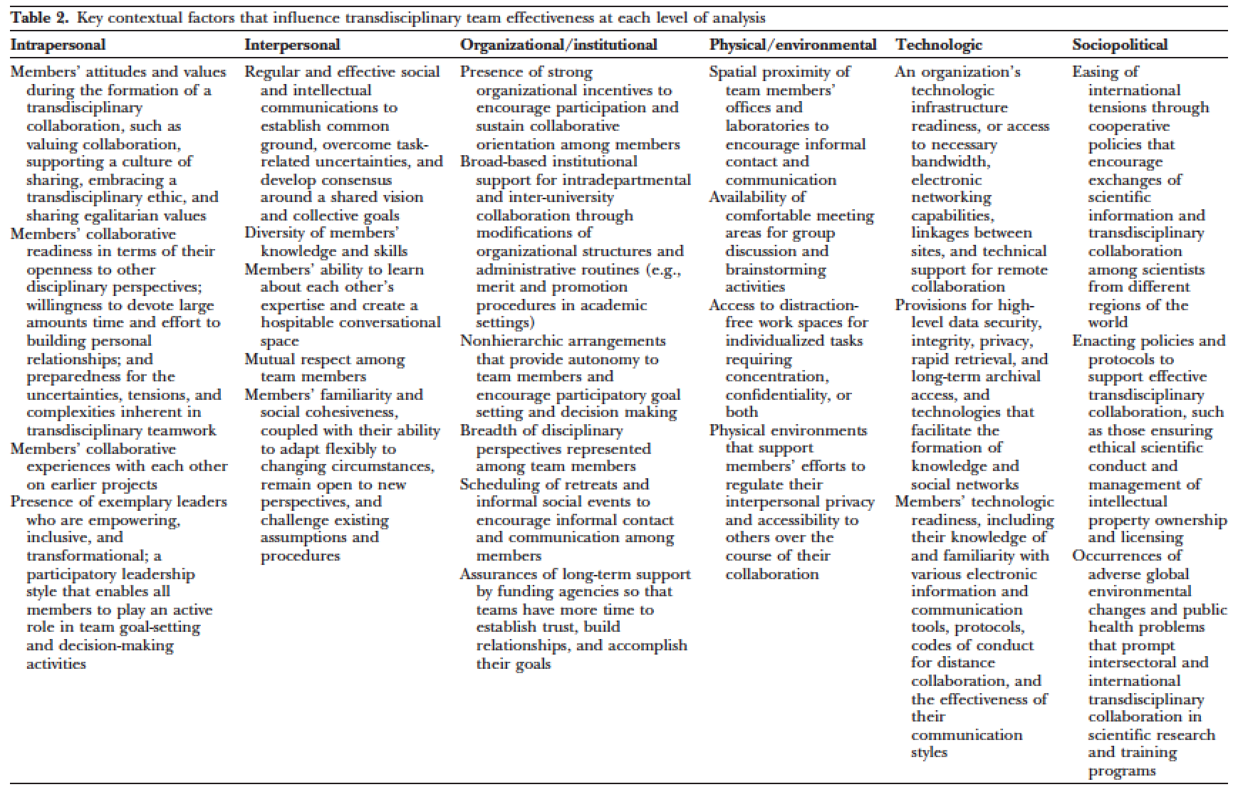
Comparison with published literature
Intrapersonal (motivations)
Interpersonal
Institutional/organizational
Physical/environmental
Technologic
Sociopolitical
Stokols et al. (2008) The ecology of team science. J. Prev. Med.

Slide 28
Challenges of team science
National Academy of Sciences (2015) Enhancing the Effectiveness of Team Science
High diversity
Deep knowledge integration
Large size
Goal misalignment
Permeable boundaries
Geographic dispersion
Task interdependence
INTERPERSONAL FACTORS

Slide 29
Discussion
Of the categories identified, which do you think are the most influential and why?

Slide 30
Part 4: The EMBeRS Approach

Slide 31
Ecosystem analogy
ENVIRONMENT
(CONTEXT)
ECOSYSTEM
NICHE
NICHE
Cross-scale flows:
Energy, water, nutrients
NICHE
Systems thinking: system components + interactions between components

Slide 32
Systems Thinking about the Team
Emergence of system properties:
Shared model of the problem; Shared vision of integrated research; Aligned research goals; Personal research niches
Context/Environment
Sociopolitical,
Organizational/
Institutional
Factors
Components (Structure):
People with heterogeneous perspectives
Methods/tools enabling interactions
Interactions (Function):
Participatory, inclusive, and empowering leadership style
Adaptability & flexibility: Evolving the team system
Ability to learn each others perspectives
Development of respect for expertise
Development of common ground
Within-team structure & function
Other products:
Material artifacts
Shared vocabulary Social ties
Collaboration skill
Physical,
Social &
Technologic
Factors
Scale
Intrapersonal
Factors
Modified from (Pennington 2011)
Notes:
Excerpt from: Pennington, D. (2011). Collaborative, cross-disciplinary learning and co-emergent innovation in informatics teams. International Journal of Earth System Informatics, 4(2), 55–68.
Figure 4 (caption). Conceptual model of cross-disciplinary teamwork. Teamwork occurs in a context or environment that includes all of the ecosystem components outside of the team itself, occurring at the same, higher, or lower scales. The team has a structure described by the numbers and kinds of components (people from different disciplines, relevant tools and resources). Components have functions based on interactions. Empirical studies of collaborative research teams suggest that four interactions, in particular, predict successful efforts.
Text: We know from studies of other systems that while system components and the environment are important, it is the development of linkages and connections between these, through interactions, that bring about system level properties (Levin 1998). Shared vision and aligned research goals are system level properties that must emerge from interactions between team members (Figure 4). As interactions occur, team leaders must orchestrate those interactions such that members learn about each other’s perspectives, conceptual linkages are identified, and common ground is constructed. From that common conceptual ground, a shared vision and aligned research goals emerge. Because the emergence of shared vision and aligned research goals depends primarily on the development of conceptual connections between participants, the focus of early team interactions should be on identifying and building any conceptual linkages, not just researchable connections. If enough conceptual linkages are constructed a threshold will eventually be crossed that allows interdisciplinary research problems to emerge. For instance, Pennington, Michener et al. (2008) reported problems relating informatics subjects to ecology researchers that improved when the focus was shifted to showing applications in other fields. Though the specific applications were not the research focus of the ecologists, and the specific informatics topics were not necessarily the focus of the IT experts, the scientists were better able to grasp other abstract informatics topics if they could first make a conceptual connection via another science field. This same phenomenon was reported by Pinheiro da Silva et al. (2010), where they struggled with connecting concepts between IT experts, mathematicians and geoscientists until they shifted their focus to examples of application in astronomy. Once those connections were made, they were able to move forward with geosciences applications. Pinheiro da Silva et al. (ibid.) provide an interesting mathematical explanation for this phenomenon.
This implies that a period of exploratory learning about each others’ disciplines and discussion of potential linkages is essential, and that adequate time must be allotted for this to take place. It also implies that initially problem definition will be vague and that it may remain vague until that threshold is crossed. Participants should expect this to be the case, and have patience while the connection-building process occurs. Normative factors must be in place that will motivate extended engagement. Participants should also expect that the search for linkages between disciplines will require that they learn about other perspectives, and allow the way they think about their own research to be changed by those perspectives – hence the need for adaptability and flexibility. Participants who have specific, narrowly focused research interests that they want to pursue are less likely to be able to contribute to an integrated conceptualization.
In addition to system-level properties that emerge, other team outcomes are produced (Figure 4): a shared vocabulary develops, material artifacts are created, social ties are strengthened and participants build up collaboration skill.

Slide 33
Challenges of team science
High diversity
Focus here
Deep knowledge integration is difficult
Goal misalignment
Task interdependence mistakes
“Vote with their feet” through permeable boundaries
Exacerbated in large, dispersed teams

Slide 34
What kind of activities? The EMBeRS method
Participatory, inclusive, empowering processes
Iterative – evolve the team system
Enable learning about perspectives
Purposeful search for connections – not research ideas (these will emerge) but linkages between concepts and/or methods

Slide 35
INPUTS
ACTIVITIES
OUTCOMES
Discipline 1
Discipline 2
Facilitator/Leader
Group
information
sharing
Emergent problem model
& shared research vision
Iterations
Divergent
Thinking Activity
(brainstorming)
Starting
problem
definition
Evolved, more focused problem definition
Expose
Individual
ideas
Dialogue
Reflection
Learning
Dialogue
Reflection
Learning
Synthesized
interests
New mental models
& connections
Convergent
Thinking Activity
Modified from Pennington 2011
Notes:
Excerpt from: Pennington, D. (2011). Bridging the disciplinary divide: Co-creating research ideas in eScience teams. Computer Supported Cooperative Work, Special Issue on Embedding eResearch Applications: Project Management and Usability, 20(3), 165–196.
Hence, the participatory process in this setting must target the slow negotiation of co-created ideas rather than the rapid output of individual ideas. This requires an approach that enables everyone to be not only heard, but understood. Background information necessary to understand an idea must be effectively communicated, and potential connections must be explored in depth. Potential cross-disciplinary connections should be followed through with thought experiments and a tolerance for ideas that do not immediately make sense to everyone. There is a qualitative different between questioning in order to achieve understanding and questioning as a form of critique. Pickett et al. (1999, p. 305) note:
“Of course, an emerging cross-disciplinary collaboration project will be incomplete, will contain erroneous components, and may have indistinct scope. All of these failings must be ultimately corrected. However, to yield to the critical impulse too soon in the process may thwart a cross-disciplinary collaboration effort. Premature or overzealous application of the critical impulse is akin to allowing the editorial impulse to act too soon in the process of writing. The result is often ‘writer’s block’ and a perpetually blank page.”
A balance must be achieved between divergent thinking and learning activities that allow cross-disciplinary ideas to “fill the page” and convergent thinking activities that explore those more critically to arrive at a selection of ideas that have the most potential for providing a collective path forward (Figure 2). Each CI-Team activity was designed to iterate over divergent and convergent thinking activities. Both kinds of activities were combined with learning activities that enabled better understanding of other disciplinary research approaches. Iterating over these activities generated new conceptual content and connections, more effective creative exchange of ideas, and generation of aligned research ideas.

Slide 36
Learning perspectives
Individual learning impacted by group processes
Depends on:
How knowledge is communicated about a topic
How well that content is grasped and understood
How easily the content is connected with one’s own knowledge of that topic (or a related topic)
How new connected content changes one’s own mental models of the topic
How well the newly generated mental model is communicated
Back to beginning

Slide 37
Mental models & conceptual change
Perspectives 1…n
+/- Motivation
If < threshold
Exit collaboration
1
11
5
+
+ Integrated Knowledge Capital
2
10
+ Collaboration skills
+ Social ties
+ Shared problem models
+ Transactive memory
- Knowledge heterogeneity
Group
Knowledge
exchange
+ Collaboration
Capital
Models & Boundary objects
+ Shared
Vision
6
9
3
4
7
8
Collaborative
Action
Individual
Transformational Learning
+ Nexus
Points
If > threshold
EMERGENCE
Many
Other
Factors
LEGEND:
STATE
PROCESS
Pennington (2016)
Notes:
Excerpt from: Pennington, D. (2016). A conceptual model for knowledge integration in interdisciplinary teams: orchestrating individual learning and group processes. Journal of Environmental Studies and Sciences, 6(2), 300–312. https://doi.org/10.1007/s13412-015-0354-5
Integrated knowledge capital (Figure 1 Step 1).
The model begins with two or more individuals engaging in the context of some ill-structured problem, each with a starting disciplinary perspective (perspectives 1…n). The perspectives could be very similar (e.g. two individuals from closely related disciplines) or very different. They need to link their knowledge in ways that generates integrated knowledge capital. Integrated knowledge capital is the not the union of knowledge from both perspectives, because not all knowledge a given individual holds is connected to knowledge held by other team members. Rather, integrated knowledge capital is something less than the union of team members’ knowledge, and may be much less if the disciplines are very different. In addition, the available integrated knowledge capital might or might not be particularly relevant to solving the problem at hand. What is needed is to integrate select knowledge of participants in ways that create interesting linkages across disciplines. In the terminology introduced in Box 1 the goal is interdisciplinary or transdisciplinary knowledge for solving the problem, rather than multidisciplinary knowledge, and in particular, interdisciplinary knowledge that leads to novel insights.
Integrated knowledge capital has two properties of interest that can be qualitatively understood as:
Conceptual distance between two individuals is a function of how different their knowledge is, and how many integrative linkages exist between their knowledge bases; and
For collaborations consisting of more than two individuals, there is a conceptual configuration that results from all of the pairwise conceptual distances, and if it could be measured, would quantify knowledge heterogeneity of the team.
A primary goal of group interactions in interdisciplinary teamwork is to minimize conceptual distance between individuals through enabling learning across disciplines, thereby reducing the knowledge heterogeneity of the team. This reduction brings a team more in line with Wenger’s (2000) suggestion that the best group results are obtained when collaborators’ knowledge is not too similar nor too different.
Designing knowledge exchange activities (Figure 1 Step 2)
The group engages in a knowledge exchange activity that has some efficiency for finding connections between disciplines. If the participants are from very similar disciplines and already have a good deal of integrated knowledge capital, this activity may follow traditional modes of scholarly engagement, including formal presentations in a seminar or workshop or an ad hoc conversation over lunch. If, however, the participants are from very different disciplines these traditional modes of engagement are not effective. Participants have limited ability to understand either formal presentations or informal discussion by colleagues from other disciplines. Rather, a structured process should be designed that targets exploring the problem space from different perspectives and enabling learning about those perspectives. This would involve each team member representing his/her perspective on the problem and group discourse to clarify and explain information that has been shared, discuss how it connects with other’s knowledge, and evaluate how interesting these potential connections are.
Using model-based reasoning strategies (Figure 1 Step 3)
Applying model-based reasoning and associated theoretical constructs previously discussed, a theory-based strategy for group knowledge exchange could involve designing an activity that externalizes each person’s mental model about the problem as a boundary negotiating object and facilitating group reasoning around those external representations (see Box 2 for definitions of terms). Written externalizations (e.g. diagrams, whiteboard drawings, illustrations, concept maps, and a multitude of other visual forms that might be generated) are products of the process but also act as inputs that improve the efficiency of connection finding through cognitive offloading. These enable negotiation of a shared model of the problem. Visual aids are a critical part of conveying and learning complex subjects. Thus, there is interplay between the group activity and individual learning that is mediated by external representations in the form of boundary negotiating objects (see Pennington et al., this volume for additional details on this process).
Individual transformational learning (Figure 1 Step 4)
As group knowledge exchange occurs, each individual is learning about other team member’s perspectives on the problem and transforming their own conceptualizations to accommodate these new perspectives. If the disciplines involved are very different, it may be exceeding difficult for participants to grasp the other perspectives on the team, much less make the cognitive transformations to integrate these with their own disciplinary conceptualizations. Tolerance for seemingly basic questions and tangential discussion is imperative. What is basic to one is new territory for others, and what appears to be tangential may be the beginning of a novel idea. However, these explorations of the problem space must have some bounds, and a leader is needed who can navigate the subtle difference between exploring a potentially interesting idea and being distracted into discussions that are ultimately dead ends. As the problem space is explored, all individuals will learn, transform their understanding, and generate new conceptualizations of the problem. These new conceptualizations are more integrative than prior models of the problem, yet they are unique to each individual rather than being shared by the group.
Changing shared problem models and transactive memory (Figure 1 Step 5)
As a result of this cognitive processing, the number of conceptual connections between team members increases, positively impacting the development of shared problem models and transactive memory of each individual’s perspective on the problem model, and reducing the heterogeneity of knowledge on the team. More integrated knowledge capital is available to participants as they continue to engage each other.
Changing individual motivation (Figure 1 Step 6)
As the team iterates through this process developing shared problem models and transactive memory, some participants will become more motivated to collaborate and others less so, depending on how well they are able to map their own research interests to the shared problem model that is emerging. For some, the direction generated by the group will not motivate them to continue and they will leave the collaboration. This can be thought of as a threshold that is unique to each individual, beyond which the perceived cost of collaborating with the group is higher than the perceived benefits. For others, continued learning and connection finding will enable them to not only map their research interests to the emerging shared problem model, but the process of transforming their personal mental models to achieve this will lead them to think about their research in entirely new ways.
Generation of nexus points (Figure 1 Step 7)
Connections between individual conceptualizations of the problem grow until one or more individuals may suddenly significantly restructure their problem model, leading to an “aha” moment when novel integrated ideas crystalize. This is conceived of as the emergence of “nexus points,” novel connections that are central to the developing problem model. This can also be thought of as a threshold. Conceptual connections between participants build in complicated ways until there are enough connections for a novel, complex connection to be generated. This nexus connection point is truly interdisciplinary and leverages content from multiple disciplines.
Generating a shared research vision (Figure 1 Step 8)
As nexus points emerge, these connections bind multiple perspectives together and form the basis of constructing a shared research vision. The research vision is different but related to the problem model. The problem model could take many forms that might be interesting in different contexts. These are specifically relevant to interdisciplinary research contexts, which require not only that the problem model exist and span multiple disciplines, but also that research questions are generated that are legitimate contributions to knowledge in the different disciplines that are involved. Problem models are generated in step 5. It is the emergence of interesting, central nexus points in step 7 that leads to a novel, shared vision of research.
Other outcomes from group activities (Figure 1 Step 9)
Additional outcomes from group activities are skills gained through the process of engaging, and social ties with collaborators. These are not the focus of this article, but are recognized in the model as directly impacted by the design of group activities.
Collaboration capital (Figure 1 Step 10)
Shared vision, collaboration skills, and social ties are key contributors to collaboration capital, the resources available for subsequent collaborative action. There are other factors that are important to interdisciplinary team science, including availability of funding, promotion and tenure incentives, workable collaborative environments, and others that are beyond the scope of this model (Stokols et al. 2008). This article just focuses on the early stages of generating a shared vision – not the long arduous path of producing research driven by that vision.
System feedbacks (Figure 1 Step 11)
As the group continues to work they will engage in activities that build on earlier ideas, generating positive feedback to group activities. The collaboration capital that they have generated enables improvements in the efficacy of these activities. However, there is an interaction between the feedback from collaboration capital to group processing (Fig. 1 #11) and the feedback from transformational learning to integrated idea capital (Fig. 1 #5). While long-term collaboration improves the number of connections across perspectives, knowledge heterogeneity declines. Collaborators’ mental models become more similar through time, and consequently, the less creative their ideas will be (negative feedback to integrated idea generation capital).
This outcome has been observed in longitudinal studies of creative teams. Porac et al. (2004) studied a heterogeneous research team through time and found a reduction in the linguistic variety of output, indicating increasing conceptual redundance. Berliant and Fujita (2008) found that creativity is strongly tied to team heterogeneity, and that the process of cooperating generates common knowledge that reduces team heterogeneity. Guimera et al. (2005) found that to generate radically new ideas on an ongoing basis, a team must have an influx of complementary knowledge in the form of newcomers to the collaboration. A novel feature of the proposed model is that it predicts these outcomes as an interaction between increasing collaboration capital and decreasing conceptual heterogeneity that has a negative impact on team creativity. Its predictive capacity lends some credibility to its validity, which will necessarily need to undergo rigorous testing in the future.

Slide 38
External Representations
Star & Griesemer (1989) Social sciences: Boundary objects – static objects that link across different perspectives (forms, etc.)
Hutchins (1995): Anthropology: Material artifacts in distributed cognitive systems
Ewenstein & Whyte (2009) Organizational sciences: Epistemic objects – evolving objects
Fiore et al. (2010) Psychology: Macrocognition – team process and external representations

Slide 39
Model-Based Reasoning
Models: Analogies, metaphor, thought experiments, visual models, semantic models and/or simulation models…
used for abstraction and communication of complex concepts
Models enable the offloading and summarizing of complex information so that individuals can grasp and manipulate more information
(Ifenthaler 2013)
Model-based reasoning:
Employing models to invoke conceptual change [e.g. learn]
Reasoning by mental modeling possibly aided by external devices
(Nersessian 1999)
Notes:
Excerpt from: Pennington, D., Bammer, G., Danielson, A., Gosselin, D., Gouvea, J., Habron, G., … Wei, C. (2016). The EMBeRS project: employing model-based reasoning in socio-environmental synthesis. Journal of Environmental Studies and Sciences, 6(2), 278–286. https://doi.org/10.1007/s13412-015-0335-8
Cognitive science research on complex scientific problem solving identifies model-based reasoning as a key mechanism for generating new scientific understanding (Nercessian 1999). Model-based reasoning begins with the idea that humans reason by constructing an internal mental model of the situations, events, and processes that they encounter. External representations can be used to facilitate construction of these mental models (see Box 2 for definitions of these terms). External representations include the use of analogies, metaphors, visual models, diagrams and/or other representations for abstraction and communication of complex concepts. In complex reasoning tasks, internal mental models are evolving as reasoning occurs. External representations capture a static view of these mental models at a point in time that aids in organizing and communicating complexly interrelated concepts. Additionally, research in cognitive science suggests that these kinds of nascent representations enable the offloading and summarizing of complex information so that people can grasp and manipulate
Box 2. Definitions of representation-related terms.
Representation: A description or portrayal of something in a particular way.
Model: A representation that provides abstraction and organization of elements that comprise reality.
Mental model: Individual, internal, cognitive simplification of reality that is formulated through experience and is relatively stable.
Shared mental models: Emergent, distributed cognitive states that are generated in real time in a specific context, reflect shared understanding of a problem (e.g. shared problem model), and evolve as group understanding evolves.
External representation: A tangible or linguistic representation of a mental model or other internal representation.
Boundary object: An external representation that functions as a mediator across the boundary between different perspectives.
Boundary negotiating object: A boundary object that functions as a mechanism for discourse regarding how differing perspectives can be mediated.
Material artifact: Representation that embodies information that coordinates action among people.
Epistemic object: Temporary instantiation of a representation that enables the unfolding of later representations.
more information (Larkin and Simon 1987).

Slide 40
Reflect & transform
MM
T₀
Mental
Model
MM
t₁
Mental
Model
t₂
Boundary
Negotiating
Object
(BNO)
Decreasing
Conceptual
Distance
t₀
SHARED
PROBLEM
MODEL
BNO
t₁
Boundary
Negotiating
Object
t₂
Mental
Model
MM
Mental
Model
t₀
Notes:
Excerpt from: Pennington, D., Bammer, G., Danielson, A., Gosselin, D., Gouvea, J., Habron, G., … Wei, C. (2016). The EMBeRS project: employing model-based reasoning in socio-environmental synthesis. Journal of Environmental Studies and Sciences, 6(2), 278–286. https://doi.org/10.1007/s13412-015-0335-8
While a wide variety of terminology has been used to describe similar processes, there is consistent recognition of a transition from largely individual to increasingly shared mental model(s) of the problem as a group interacts, and the importance of using a variety of boundary negotiating objects to support these processes. This could illustrate transition from largely multidisciplinary problem model formulation to truly interdisciplinary problem model formulation. Multidisciplinary individual conceptualizations of the problem necessarily must precede any attempt at generating integrated problem models across disciplines.
A key finding of our synthesis efforts is that externalized understandings in the form of boundary negotiating objects evolve and provide temporary, partial problem models for discussion and critique, and facilitate generation of the next, more integrated problem model. For example, group model-based reasoning can occur on the fly enabled by rapid co-creation of transitory external representations (Figure 1). These transitory representations make complex, abstract knowledge and ideas more concrete and provide a framework that enables participants to reason together. One can think of this as a process of reification, in the sense that abstract mental models are made more concrete through external representation as real, tangible products. Boundary negotiating objects are temporary, proposed problem models that represent an evolving shared mental model of the problem. The boundary negotiating objects are enablers of the process, which is otherwise hindered due to the difficulty of grasping highly abstract concepts from a field of expertise where one lacks familiarity. We hypothesize that the following sequence captures this process (Figure 2):
Participant A explains her perspective and generates boundary negotiating object 1 as a starting representation of the problem model.
Participant B reflects on boundary negotiating object 1, revises her mental models, and produces boundary negotiating object 2 as a second version of the problem model.
Participant C reflects on boundary negotiating objects 1 and 2, revises his mental models and produces boundary negotiating object 3, the next version of the problem model.
This process continues until a contingent problem model is agreed upon.

Slide 41
Summary
Complex problems with high societal relevance require working across disciplines
Integrative, interdisciplinary team science that successfully converges on co-innovative solutions is difficult due to a wide range of personal, interpersonal, and contextual factors
In particular, integration of deep knowledge across disciplines is challenging
The EMBerS method tackles the knowledge integration challenge through employing a learning-based approach informed by science of team science theories

Slide 42
Acknowledgements
2006-13 NSF OCI-0636317, OCI-0753336, OCI-1135525
2013-15 SESYNC DBI-1052875
2015-18 NSF DGE-1545404
EMBeRS team: Gabriele Bammer, Antje Danielson, Dave Gosselin, Geoffrey Habron, Dave Hawthorne, Rod Parnesll, Kate Thompson, Shirley Vincent
REMEMBER EMBERS!

